Slide 1
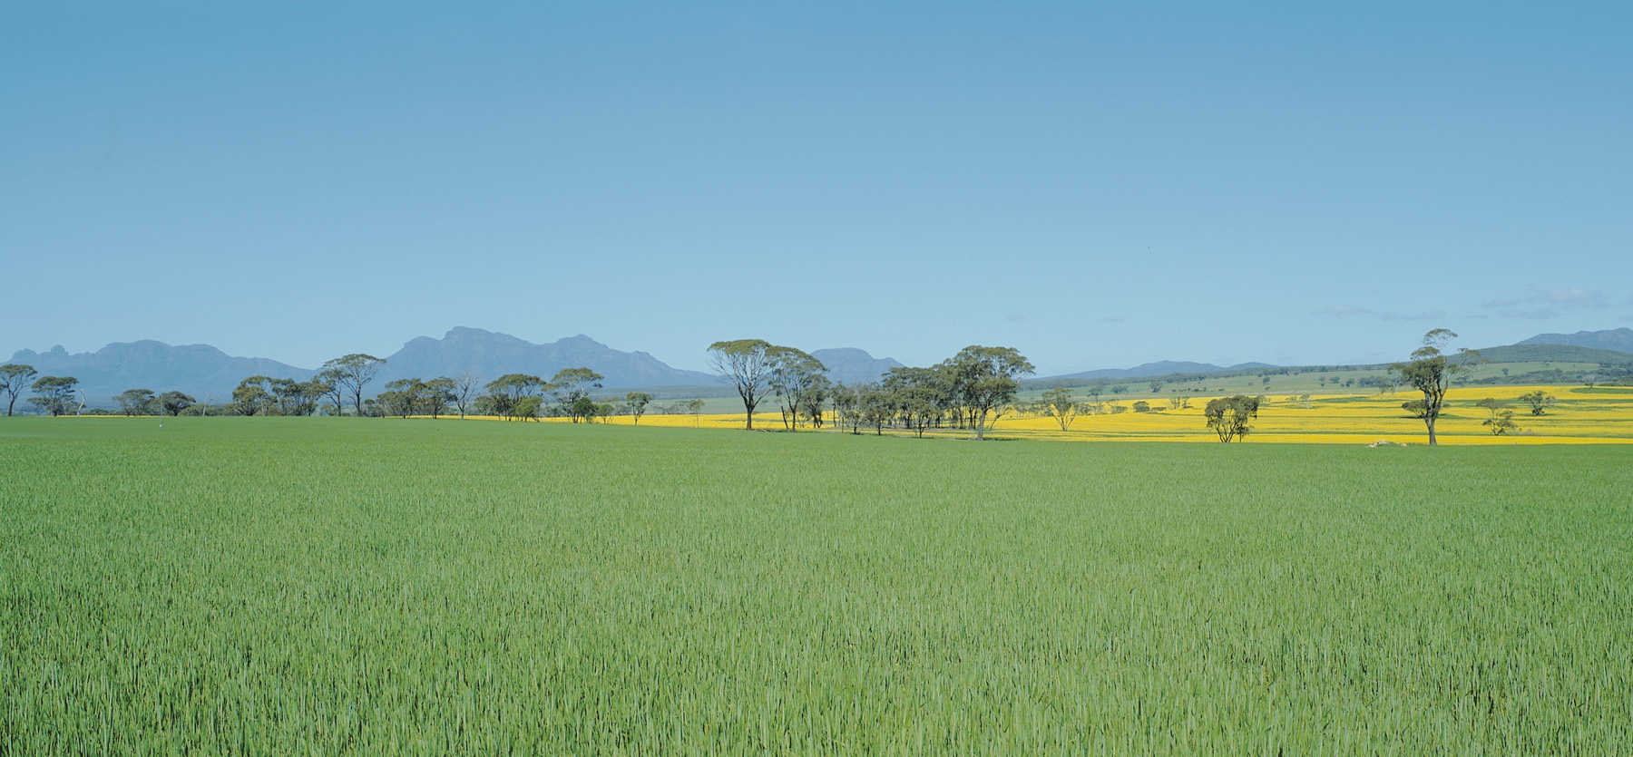





Data, designs and statistics
… for on-farm experiments
Workshop June 24th
Fiona.Evans@murdoch.edu.au

Slide 2
The goals of on-farm experimentation
On-farm:
Farmers performing large field-scale experiments to answer management questions that they are interested in.
Ensuring that farmers benefit from their own on-farm data that is already recorded by farm machinery.
Take advantage of the agTech revolution!
Off-farm:
Engaging farmers in the social processes of OFE and building networks
Building a large, shared resource of data that can be used with big data techniques to feedback information to improve agriculture as an industry.
Developing and improving methodology.
Can only arise if we can demonstrate the benefits on-farm!
Notes:
I’m going to start by reiterating some of the things that you’ve already heard from my team-mates Simon and Myrtille.
In my talk, I’m going to focus on the on-farm part of this.

Slide 3
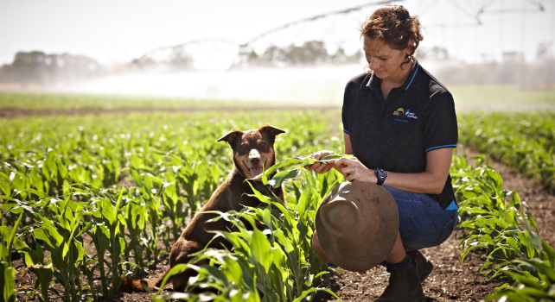
The process of on-farm experimentation
OFE that begins and ends with the farmer:
Determine the experimental question, ie. what does the farmer want to test?
Design the experiment.
Measure the results.
Analysis of results.
Take it back to the farmer.
Plan the next experiment!
Image source: www.westerndairy.com.au
Notes:
In my talk, I’m going to focus on the on-farm part of this – where OFE begins and ends with the farmer.

Slide 4
Data designs and statistics
Overview of this talk:
Common experimental designs
Data preparation
Methods of analysis:
Demonstrated using data from a strip trial from Western Australia
This presentation, ‘Anonymised’ strip trial data and R code available from:
https://github.com/fionahevans/OFEanalysis

Slide 5
The 5 golden rules
Don’t expect too much from your first experiments.
Don’t expect the answer to jump out at you from the raw yield map
Separate out treatment effects from noise (treatment effect + spatial effect + noise)
Treatment effects can vary from year to year
Treatments can interact
Bramley, R. et al. (2006). Designing your own on-farm experiments. GRDC Precision Agriculture Manual. Full PDF download available on www.researchgate.net

Slide 6
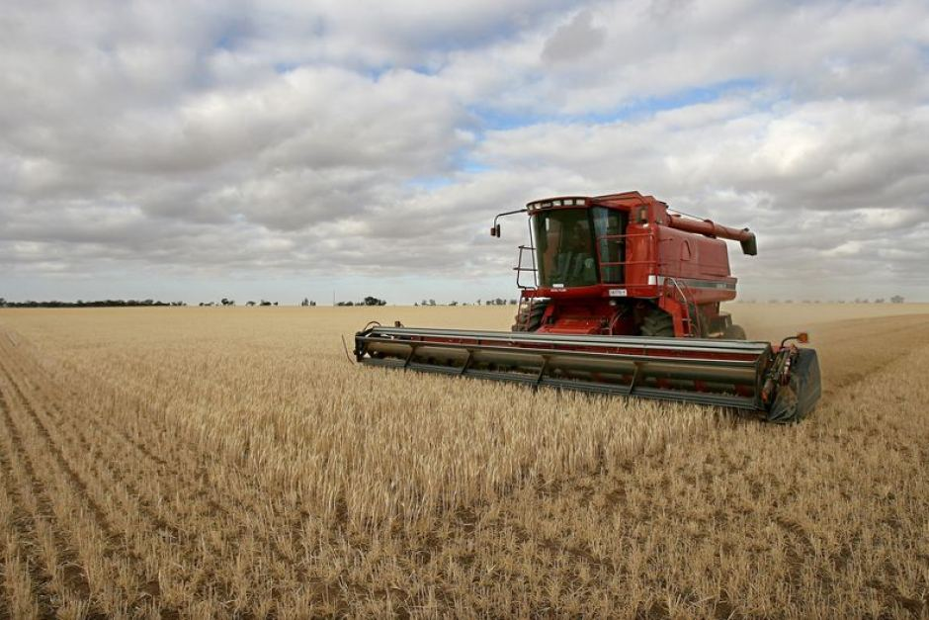
Design preliminaries
Having determined the experimental question, design requirements should plan for:
Control (do nothing) and maximum treatments
Number of variables, levels and treatments
Replication if possible
Space and machinery available
Make a field plan on paper or using
Image source: www.abc.net.au

Slide 7
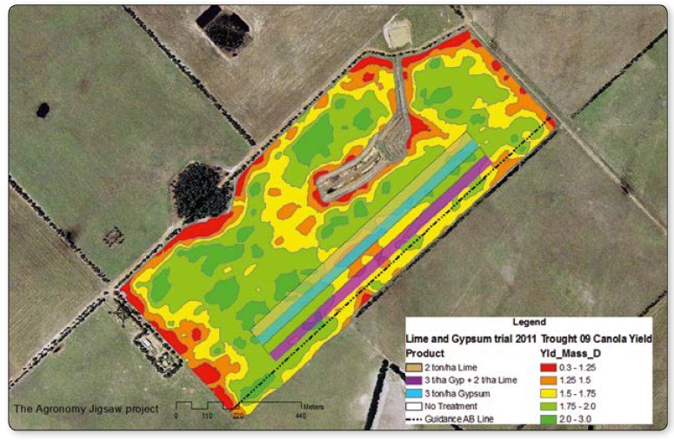
Strip trials: simple designs that don’t require VRT
Treatments boundaries run parallel to seeding, spraying/spreading and harvester runs
Strips need to be 3 times as wide as the header
Repeat or replicate as much as possible
Keep it simple
Make treatments very different
Include control strips
Hall, D. et al. (2014). The Agronomy Jigsaw. Department of Agriculture and Food, Western Australia. 4850. Full PDF available from www.agric.wa.gov.au

Slide 8
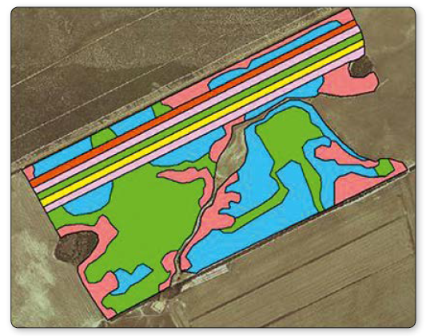
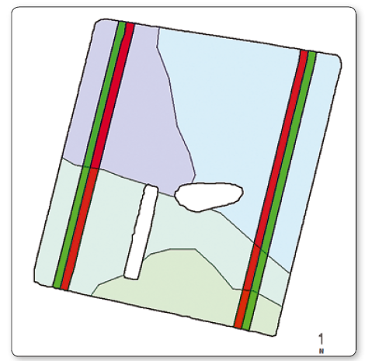
Strip trials: pros & cons
Easy to design and implement
Placement of the trials can be tricky:
If the farmer want to look at treatment response over different zones in the field (eg. soils, low and high yielding areas), then the strips have to pass over those areas
This may mean doing two simpler trials
Hall, D. et al. (2014). The Agronomy Jigsaw. Department of Agriculture and Food, Western Australia. 4850. Full PDF available from www.agric.wa.gov.au

Slide 9
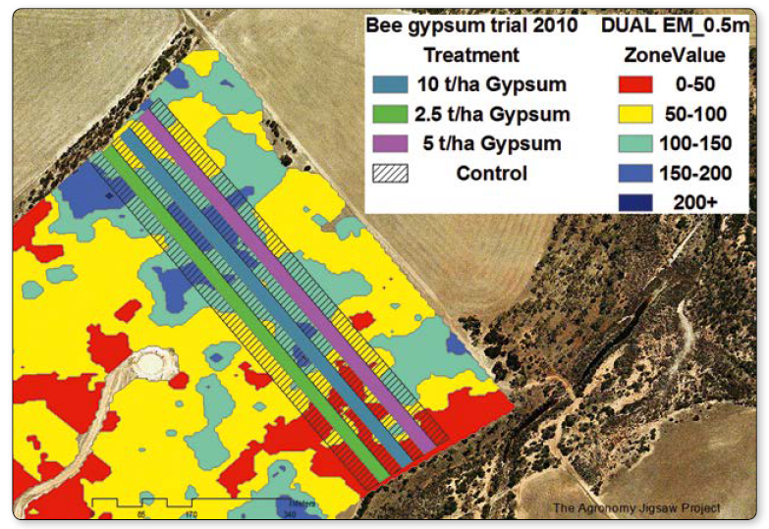
Strip trial implementation recommendations
Use a single header to harvest a trial
For strip trials, harvest the entire trial in the same direction if possible. If it’s not, jump to outside the trial strips on return runs
Keep the harvester moving at a constant speed (eg. 80% machine capacity)
Notes:
Variation in yield monitor calibration between harvesters is an obvious source of error in trial yield assessments.
There can be a 20% yield difference in yields recorded by yield monitor runs harvesting in opposite directions
Harvest stoppages can cause a surges, drops and surges in recorded yield data that has the potential to distort segments of data once extracted for analysis. Keeping the harvester at a constant speed reduces error in recorded yields, but if this isn’t possible then errors can be filtered from the data prior to analysis (later in this talk).

Slide 10
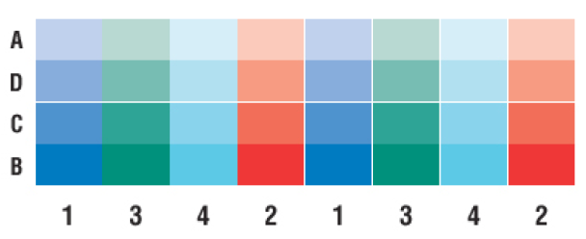

Other designs that don’t require VRT
Two way strips:
Can be used to investigate the effects of two variables
Should include maximal replication.
Not recommended if measuring yield with a weight bin.
The donut:
For farmers who prefer to sow this ‘round and round’.
Treatment widths should be three times the width of machinery used to apply treatment.
Bias in treatment sizes and location can cause problems for analysis.

Slide 11

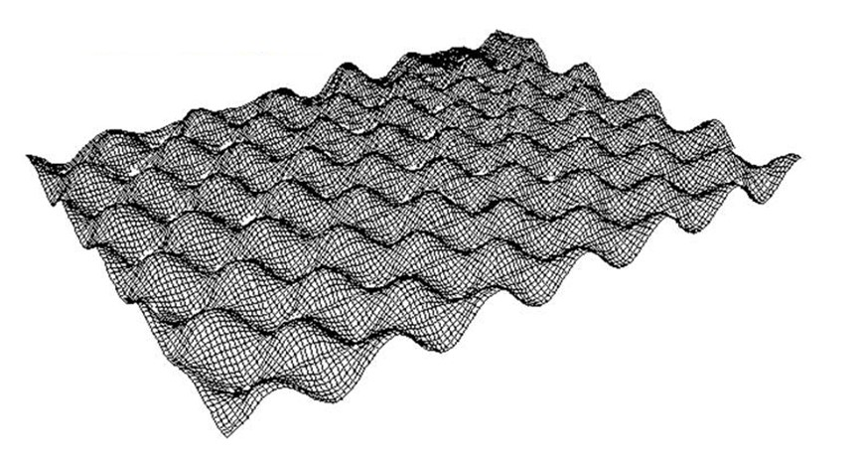
More complex designs – VRT and yield monitor essential
Goal is to remove biases caused by trial placement in simpler designs:
High amounts of replication.
Treatments cover entre field.
Can be randomised
Chequerboard design:
Can be designed to keep the cost of the experiment the same is if applying a constant rate.
Wave design:
When rate changes can’t be abrupt, use a ramped change in rate.
The golden rule when setting up a wave or chequerboard experiment is DRIVE SLOWLY!

Slide 12
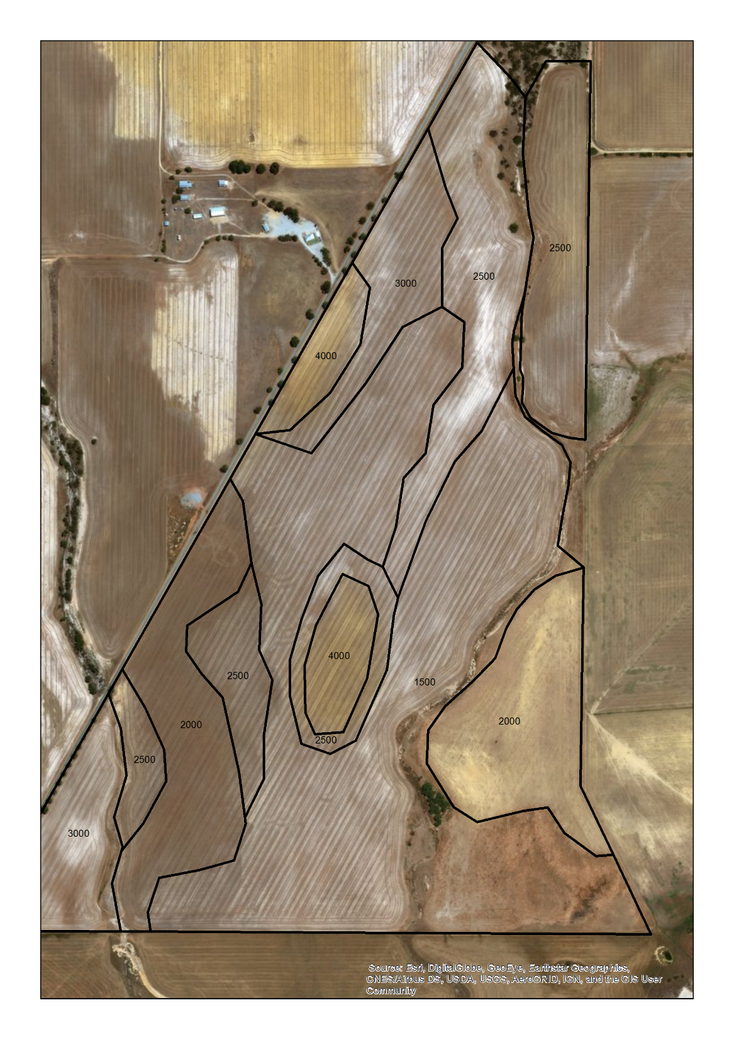
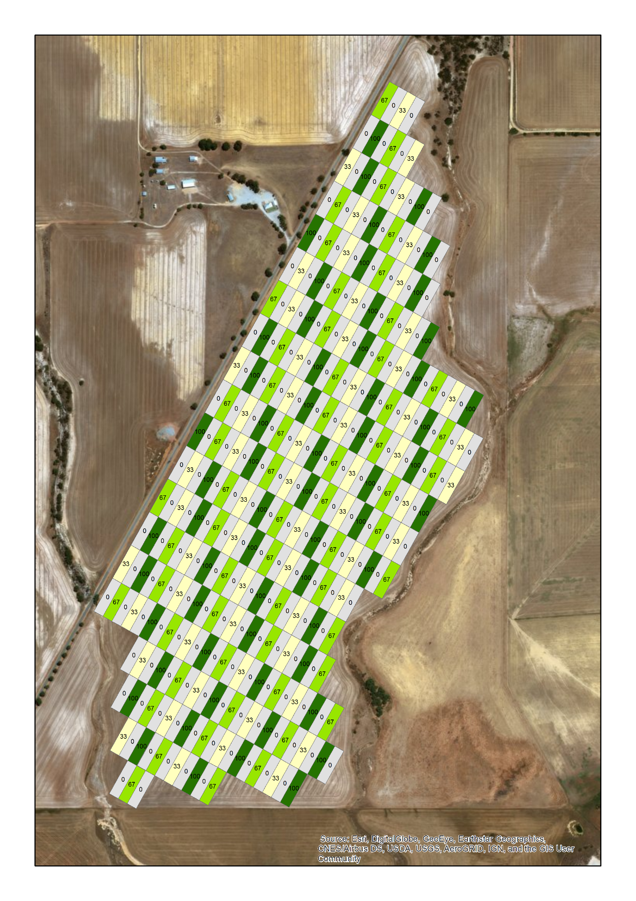
Designs will depend on the question the farmer wants to answer and the technology at hand!
Notes:
Variable rate lime was applied across the field and trial design aimed to cover the different liming zones.

Slide 13
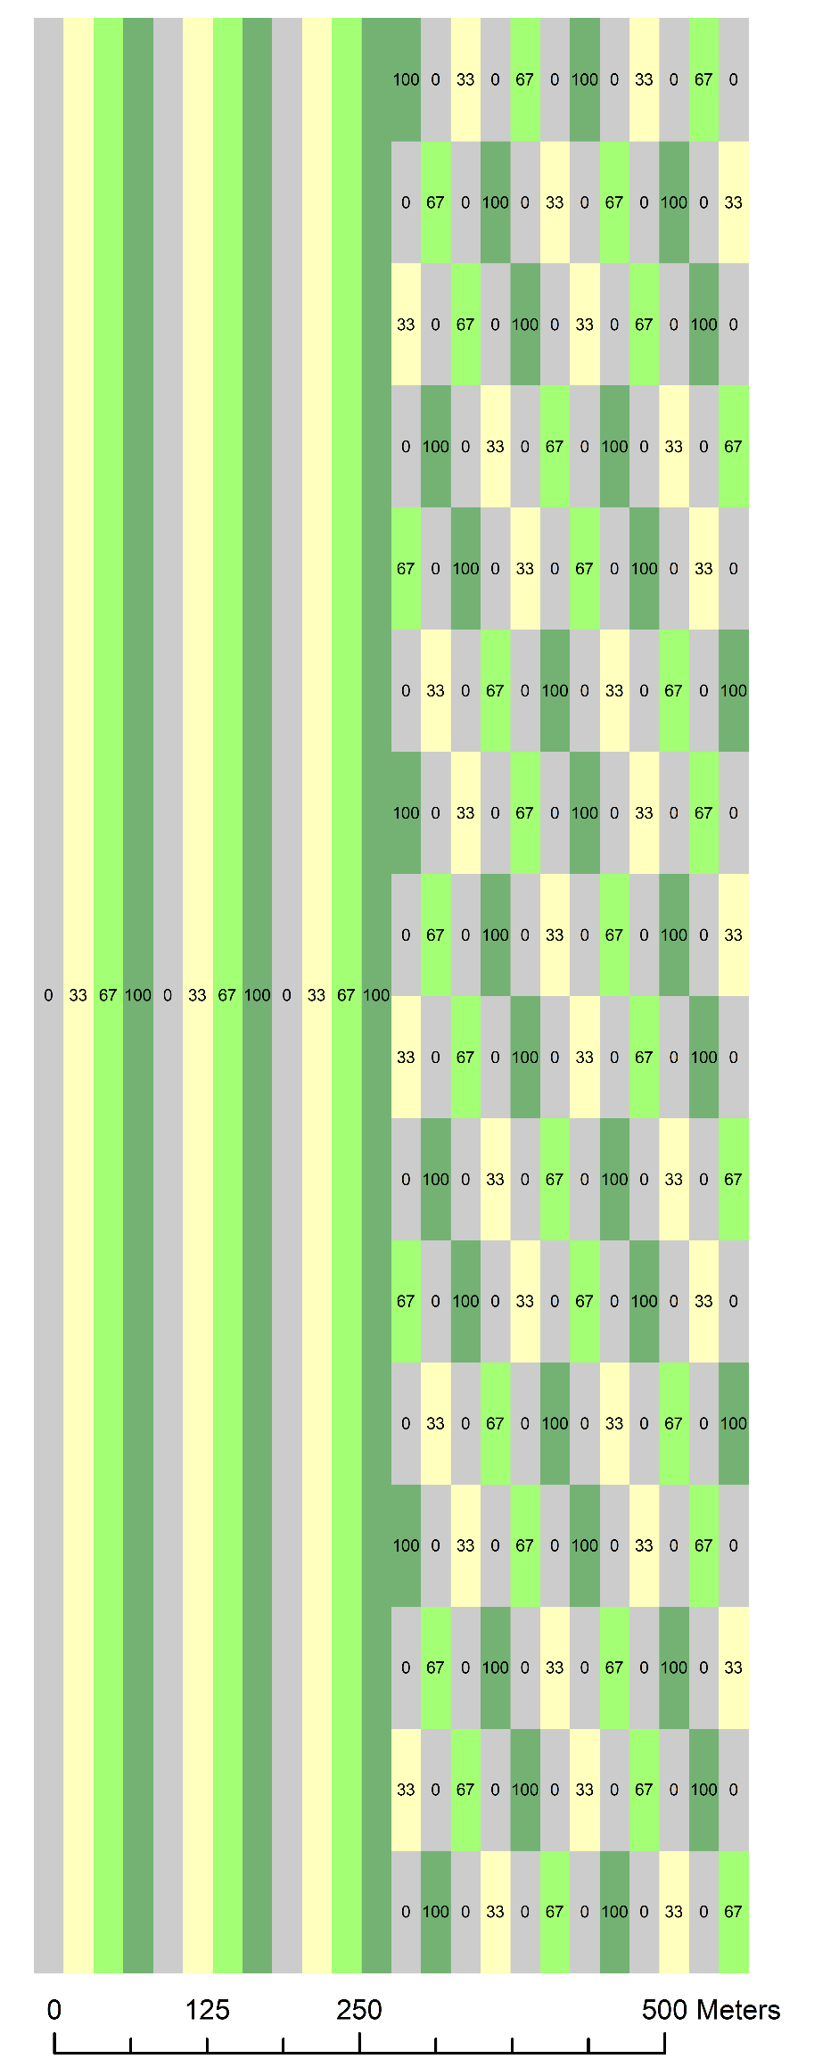
Pros and cons of different designs
Strip trials are easy to plan and implement.
Chequerboard and wave designs place treatments across all zones, but require VRT equipment.
It comes down to what the farmer is willing to do!

Slide 14
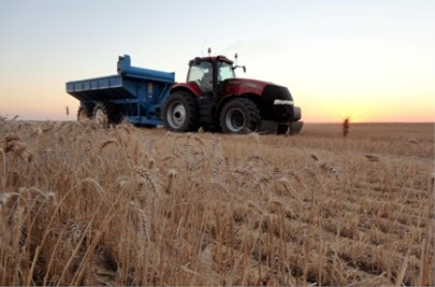
Data preparation – obtaining data
Obtaining data from farmers can be hard!
Imports from harvester to ag software can automatically perform cleaning.
Data can come in many different formats:
John Deere (RCD folder)
Case (.cn1 filetype)
shapefile
.csv
.X01
Data conversion from proprietary to common file formats :
Freeware (MapShots FOViewer)
Paid (AgLeader SMS, John Deere Apex)
Image source: www.farmweekly.com.au

Slide 15
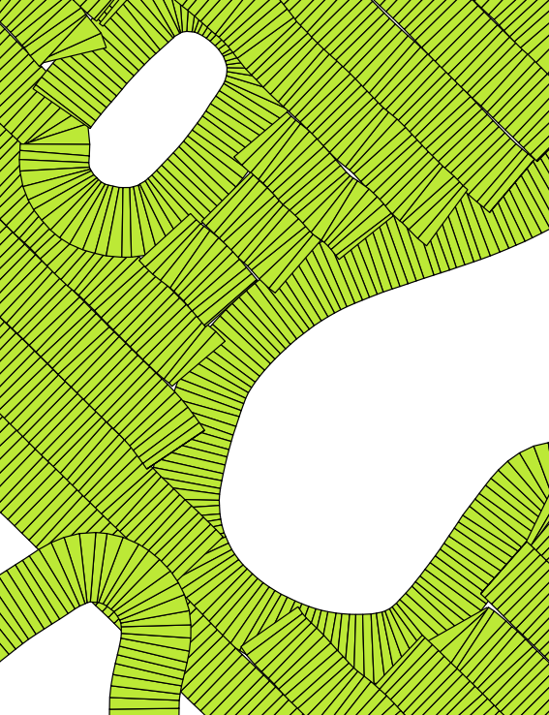
Data preparation – data cleaning
Spurious yield data need to be removed prior to analysis:
Data near turnarounds or where treatment application may have overlapped.
Where points too close together indicate a speed change.
Unreasonably high or low yields.
Min / max speeds.
Points where treatments might have been mixed.
Tools:
Yield Editor (GUI, slow and manual).
Scripts (efficient, but may require checks).
Interpolation to continuous (gridded) maps:
It’s usually best to use point data, but multi-year comparisons may require interpolation.
Image source: Phil Davis, Montana State University
Notes:
If you follow recommendations I spoke of when I was talking about designs, then data cleaning will be much simplified.

Slide 16
Data preparation – additional data
Additional data can aid the analysis:
Soil sample data.
Soil type maps.
Yield maps from previous years.
Topographic data: elevation, slope, aspect, wetness indices.
Remote sensing products, eg. NDVI and/or other indices.
Shallow EM and gamma radiometric data.
Weather data.
Sources:
Google Earth Engine.
National / state data sources.

Slide 17
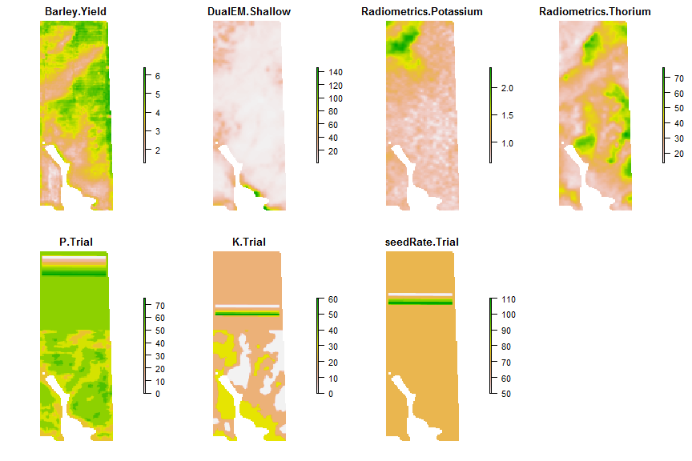
Analysis – an example data set
Three trials in 2016
We’ll focus on the Potassium (K) trial
All code in R, available from
https://github.com/fionahevans/OFEanalysis

Slide 18
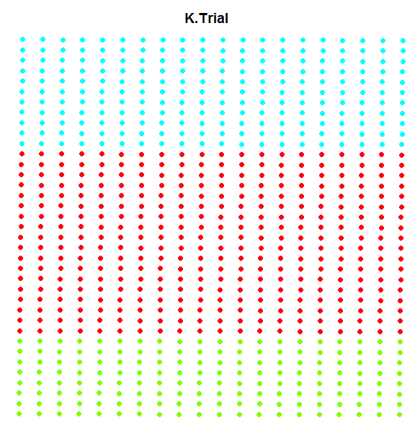
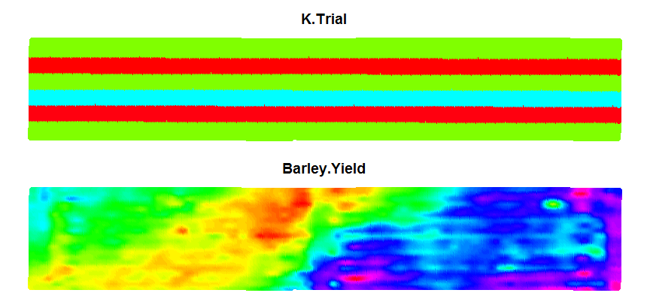
Strip trial – effect of K on barley yield
Three rates: red = 0 (control), green = 15, blue = 30

Slide 19
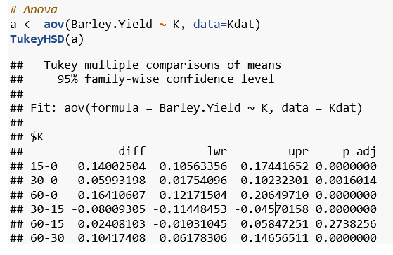
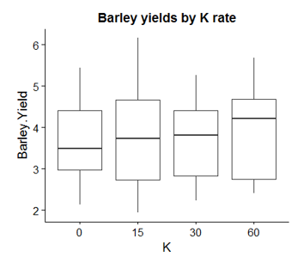
ANOVA – testing for mean differences between treatments

Slide 20
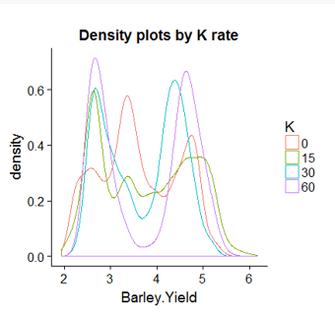
ANOVA – testing for mean differences between treatments
But… ANOVA assumes that the underlying probability density function for yield is normal!
It appears that we have 2-3 yield zones for each rate in the trial.
Ways to handle this:
Separate ANOVAs for each yield zone.
Or use zones defined some other way…

Slide 21
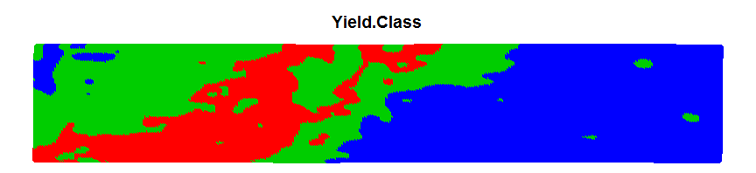
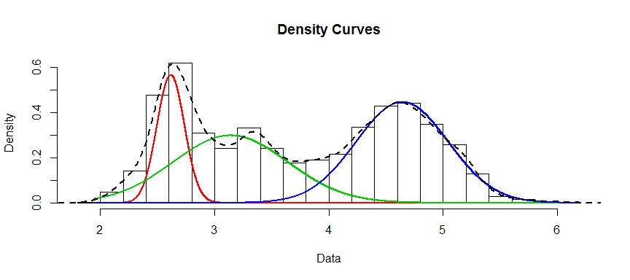
Gaussian mixture modelling to get yield zones
Automatically detect and map three yield zones

Slide 22
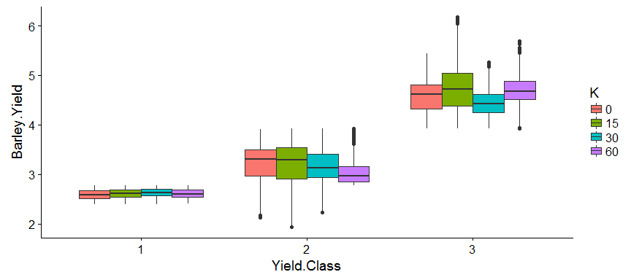
ANOVA by zone
Notes:
We can see now that there is a significant (check the Anova) difference between the three yield classes, and that each responds differently to K applications - and only the lowest yielding areas respond as would be expected (increasing yields with increasing rates up to a maximum yield).

Slide 23
What conclusions can we make from ANOVA?
Response of Barley yield to Potassium (K) is not consistent across yield zones and does not have the typical response curve shape that we would expect except for vey low yielding parts of the trial.
Does this mean that extra K is not required in the other zones? If so, the farmer could save a lot of $$
Time to talk this over with the farmer and see what he/she thinks…

Slide 24
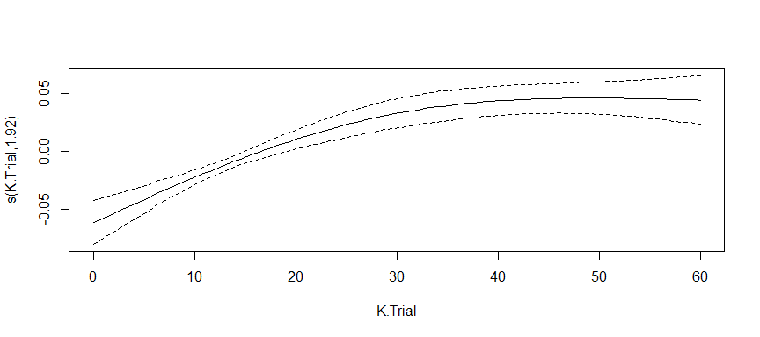
Another way of ‘looking’ at the data
Generalised additive models (GAMs) fit smooth splines to the covariate data, add them together and then apply a nonlinear function to predict response.

Slide 25
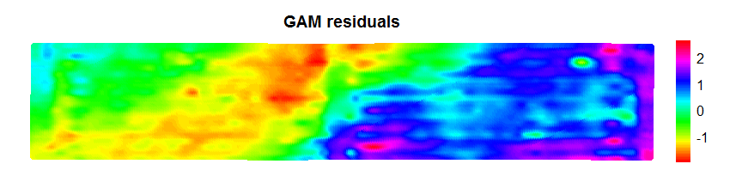
Another way of ‘looking’ at the data
But what do the GAM residuals look like…?
They look like the yield data!
The effect of K on yield is very small compared to the underlying spatial variability in yield across the trial.
We need to include the spatial variability in the model.

Slide 26
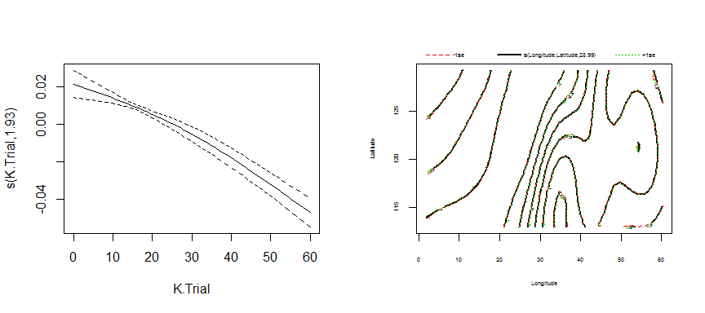
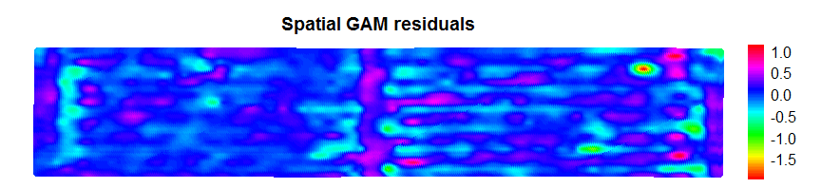
A spatial GAM
Deviance explained has increased from 0.131% to 95.3% !

Slide 27
What is spatial autocorrelation?
Data near each other are related, more so at closer distances.
How can we handle spatial autocorrelation:
Model spatial effect as an independent covariate (eg. in GAM)
Use moving window analyses where the data are weighted by distance from the central point (eg. Geographically weighted regression)
Use spatial covariates as surrogates for autocorrelation.

Slide 28
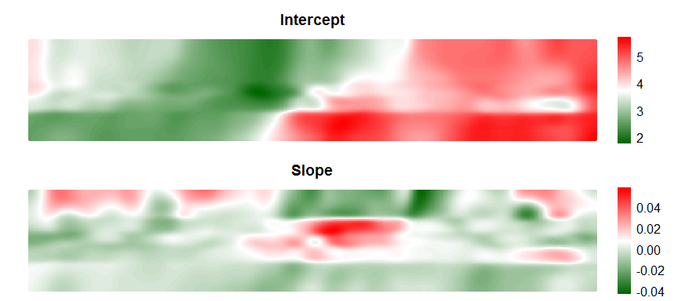
Geographically weighted regression (GWR)
See how response to treatment varies across the trial.
Several R packages exist, I recommend ‘Gwmodel’ because it is faster.
Notes:
Intercept changes with low/high yields.
Slope shows negative response to higher rates of K, and only small parts of the trial are showing positive response.
The shape of the response curve is related to yields, but what does that mean?

Slide 29
Using spatial covariates
Clustering to identify zones – we used Gaussian mixture models to identify yield zones, but multivariate GMMs can be applied to other spatial covariates.
GAMs.
Random forests.
Red = EM Green = GammaK
Blu e= GammTh
Notes:
I’ve already spoken about clustering and GAMs, so I won’t go into them here.

Slide 30
Random forests
Random forests are a method for learning from data that fit an ensemble of decision trees fitted to subsamples of the data.
They can be used to make predictions, and to determine the importance of covariates in a model.
We will use a random forest approach to determine how much of the spatial variability in the trial can be explained by measured electromagnetic and radiometric data.
Variance explained = 90.88%

Slide 31
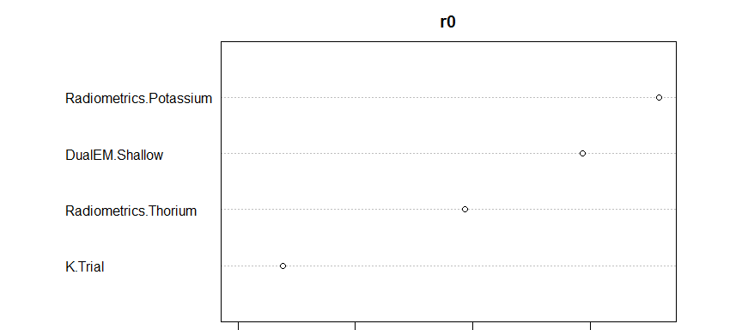
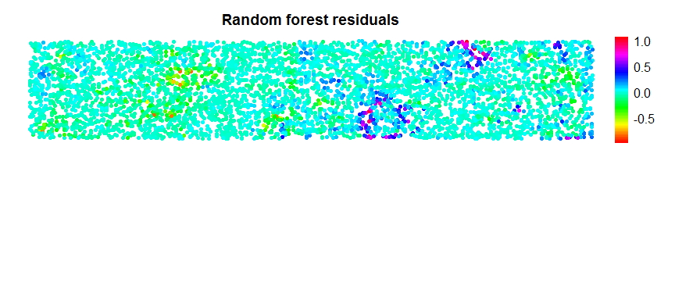
Random forests
Notes:
Some over-prediction of higher yield and some under-prediction of lower yields not fully explained by the covariates.

Slide 32
So, what has this experiment told us and where to next?
Analysis suggests that response to K is poor, and only occurring at lower rates.
Spatial variability in yield is much larger than that caused by K applications.
Spatial variability can be explained using EM and radiometrics, but what does it mean?
Farmer may conclude that:
Rates of 0-15 may be enough next year (reducing costs).
Next year’s experiment might aim to uncover causes of spatial variation besides K… but
We haven’t analysed the seeding rate and phosphorus trials yet. I leave this to you to try!

Slide 33
Summary – methods of analysis
For a trial in one year, use the yield data points rather than interpolating to a grid.
Basic analysis:
ANOVA over the entire trial or over zones as required.
Gaussian mixture modelling can be useful for identifying zones.
Generalised additive models (GAMs) can model underlying spatial variation.
Geographically weighted regression shows how treatment effect varies across the trial.
Spatial covariates can be used in GAMs, random forests and other methods to help understand causes of spatial variation.
Methods outlined for the strip trial in this talk apply equally to other trial designs.

Slide 34
Acknowledgments
My team at the Centre for Digital Agriculture.
The Food Agility CRC, who are funding our new project “On-farm experimentation” led by Prof. Simon Cook.
Collaborating PA consultants Frank D’Emden and Joel Andrew.
Previous colleagues from the WA Department of Primary Industries and Regional Development.
My research fellowship is supported by the WA government ‘Royalties for Regions’ program, Murdoch and Curtin Universities.
Fiona.Evans@murdoch.edu.au

